Slide 1



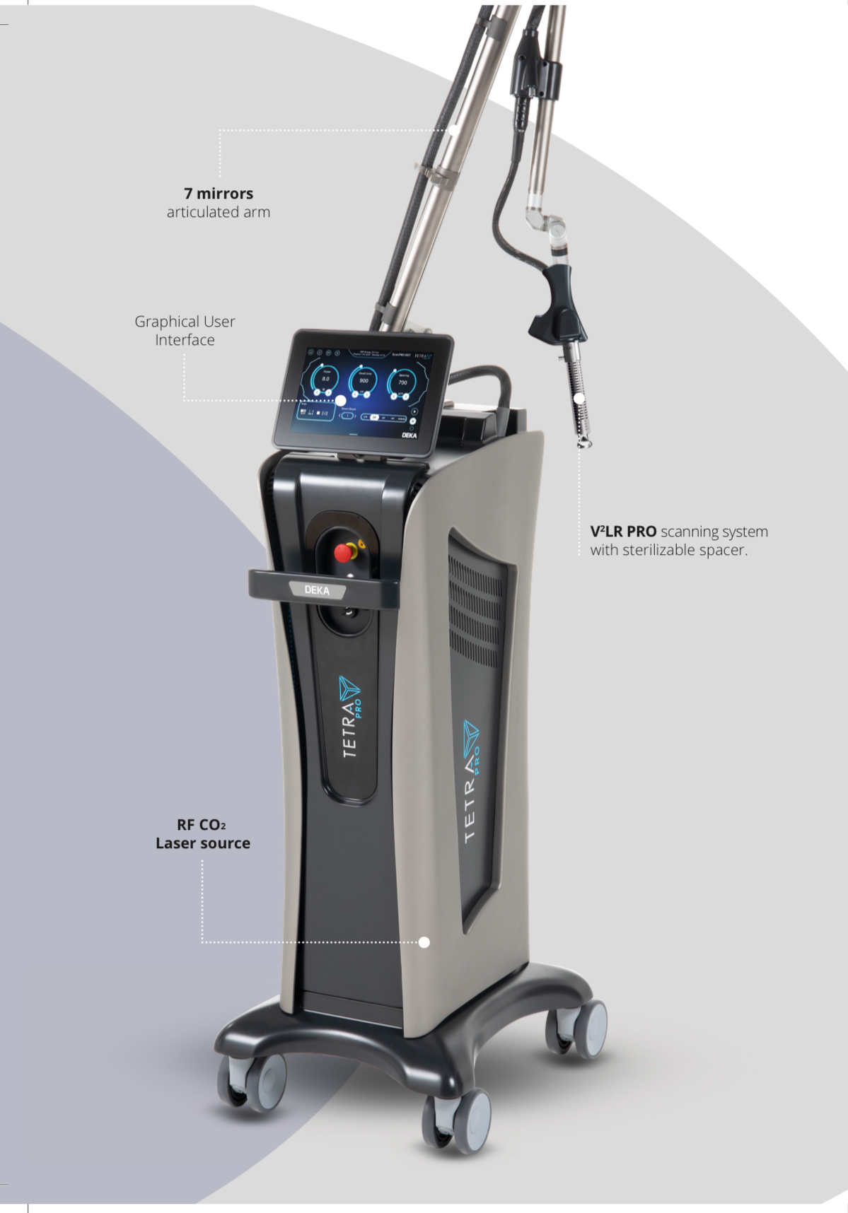
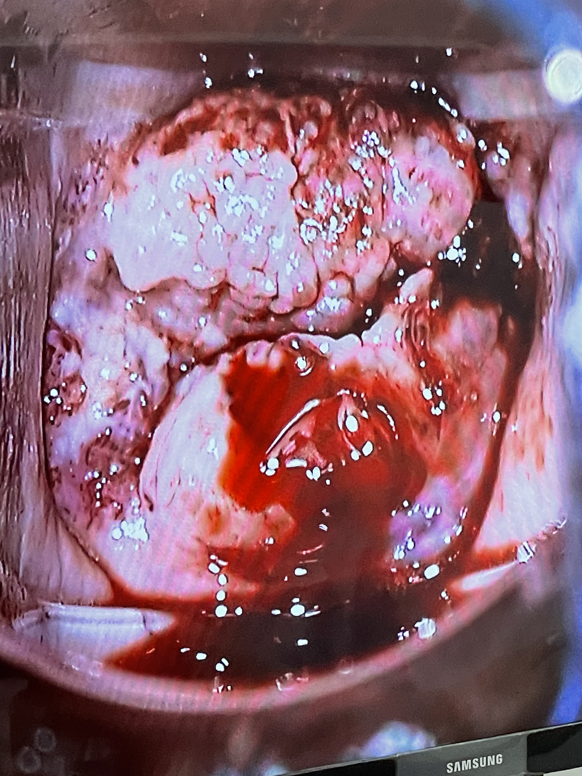
District 4140 México
ROTARY CLUB MORELIA TRES MARÍAS
Gynecological CO2 Surgical Laser

Slide 2
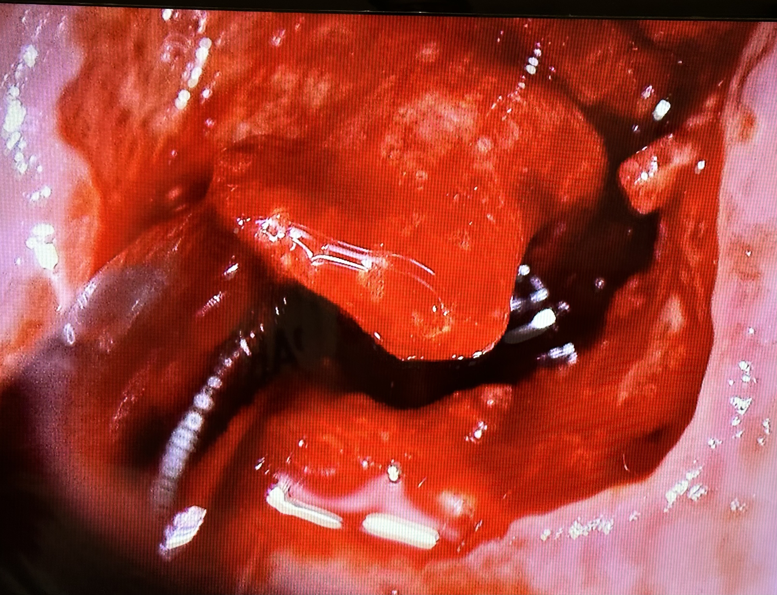
1. Introduction
HPV infection and cancer
Every 2 minutes, 1 woman dies in the world
Every 2 hours, a woman dies in Mexico
90% of anal cancer
50% of vulvar cancer
47% of vaginal cancer
50% of penile cancer
38% of head and neck cancer
99.7% of cervical cancer cases
GLOBOCAN

Slide 3


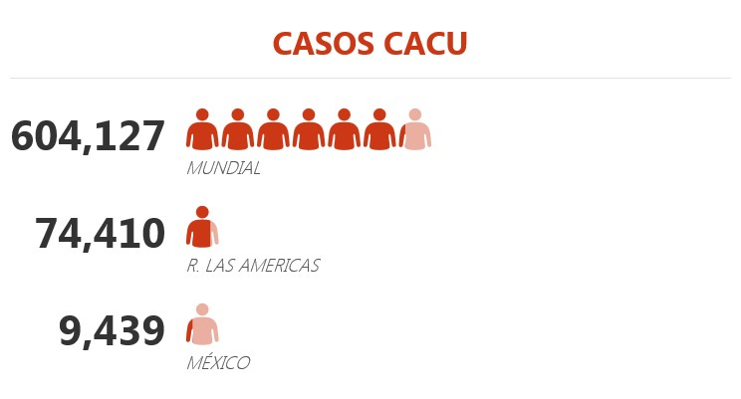


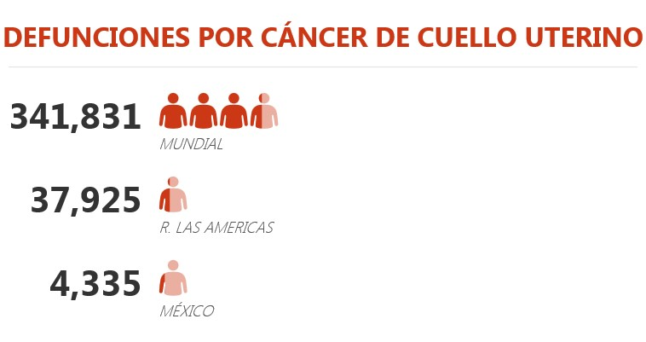
1. Introduction
Captura de Pantalla 2023-08-17 a la(s) 21.58.35
Region of the Americas (2020):
74,410 women diagnosed with cervical cancer
51% (37,925) died from this cause
•
•
México (2020):
• 9,439 women diagnosed with cervical cancer
• 45.9% (4,335) died from this cause.
Globocan
, 2020.

Slide 4
1. Introduction
Cancers Related to HPV
Cervical |  |  |  |  |  | 99%
Anal |  |  |  |  | 84%
Vaginal |  |  |  | 69%
Penile |  |  | 47%
Vulvar |  | 40%
Oropharyngeal | 35%
Oral Cavity | 23%

Slide 5
MÉXICO 2022. Cacu
México
10,348 new cases
4,174 deaths
2nd leading cause of death since 2006
Michoacán
13,168 total deaths in women aged 25 and older, of which:
1,345 (10%) malignant tumors
• CACU 11.9%
• 170 deaths
Michoacán
2nd leading cause of death
Morelia (38)
Uruapan (16)
Zitácuaro (11)
Zamora (8)
Pátzcuaro (7)
Lázaro Cárdenas 6
Tacámbaro (6)
129 new cases.
Incidence of 9.1/100 000 womens
Apatzingán, Morelia y Pátzcuaro
SICAM

Slide 6
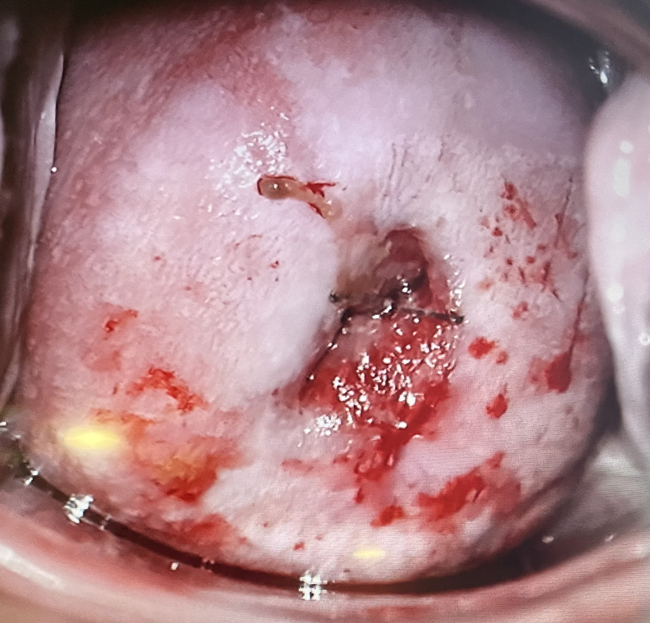
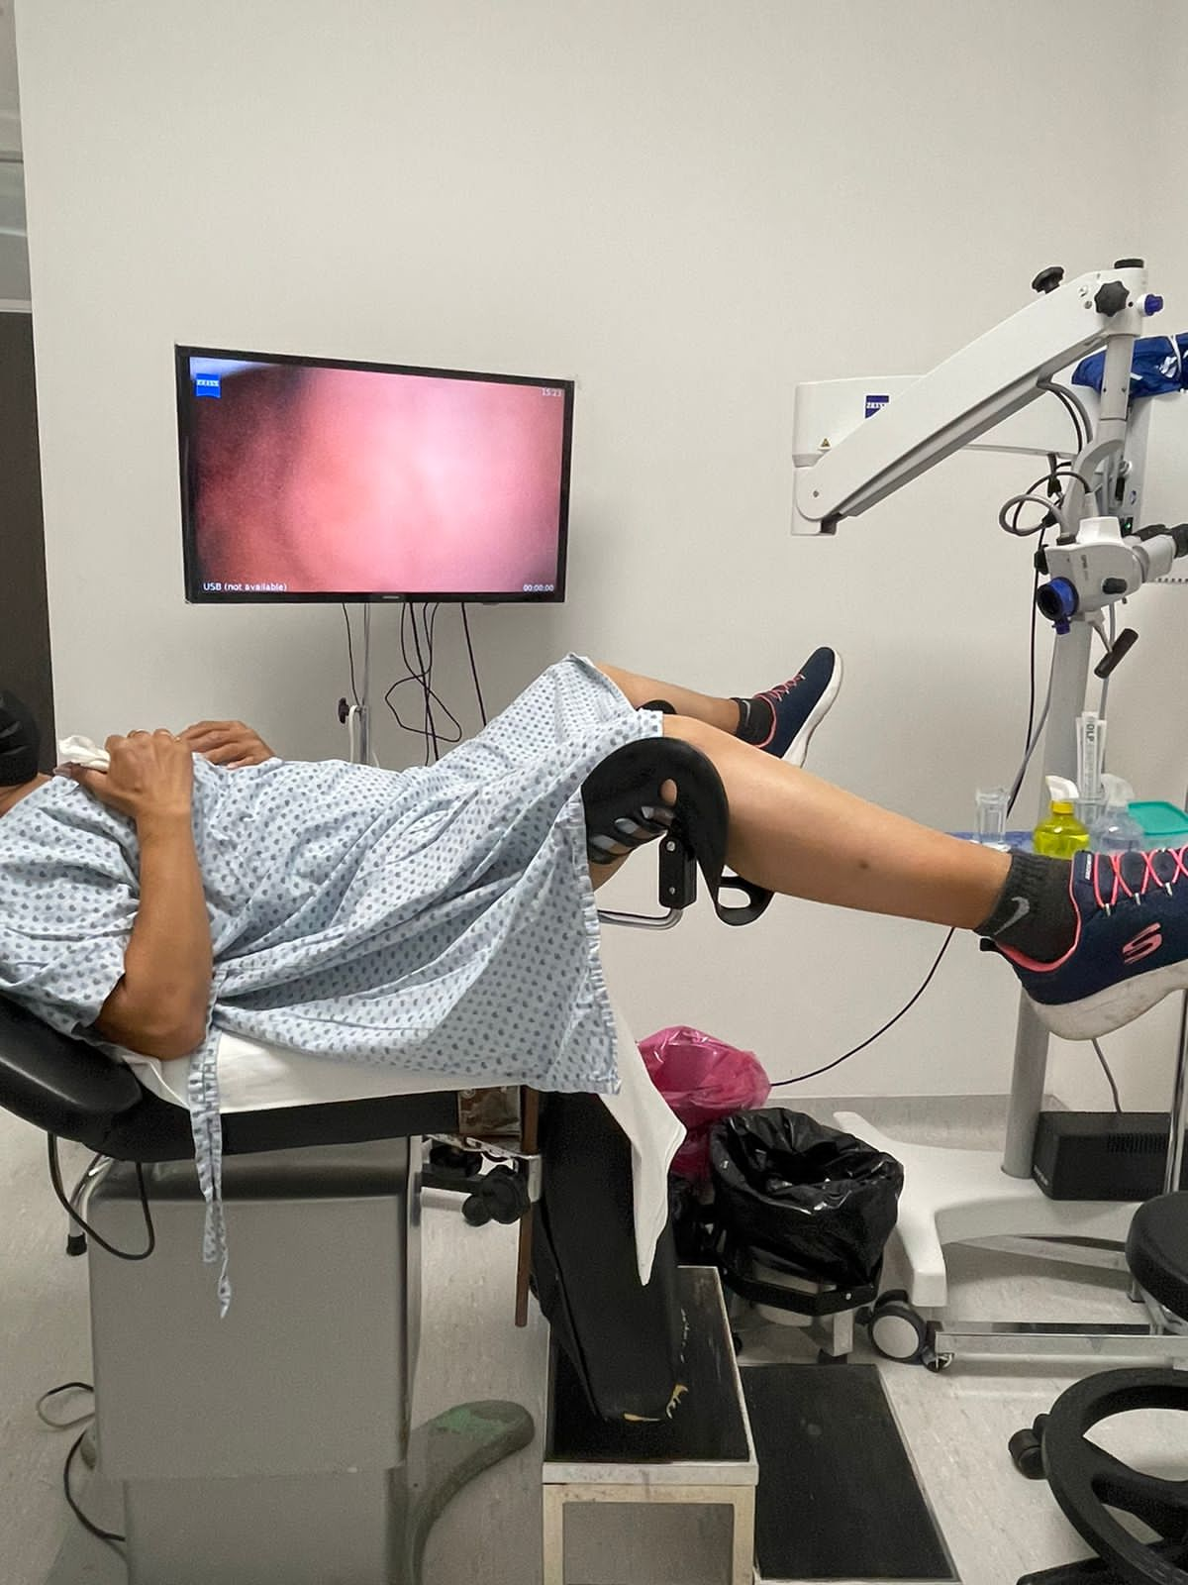
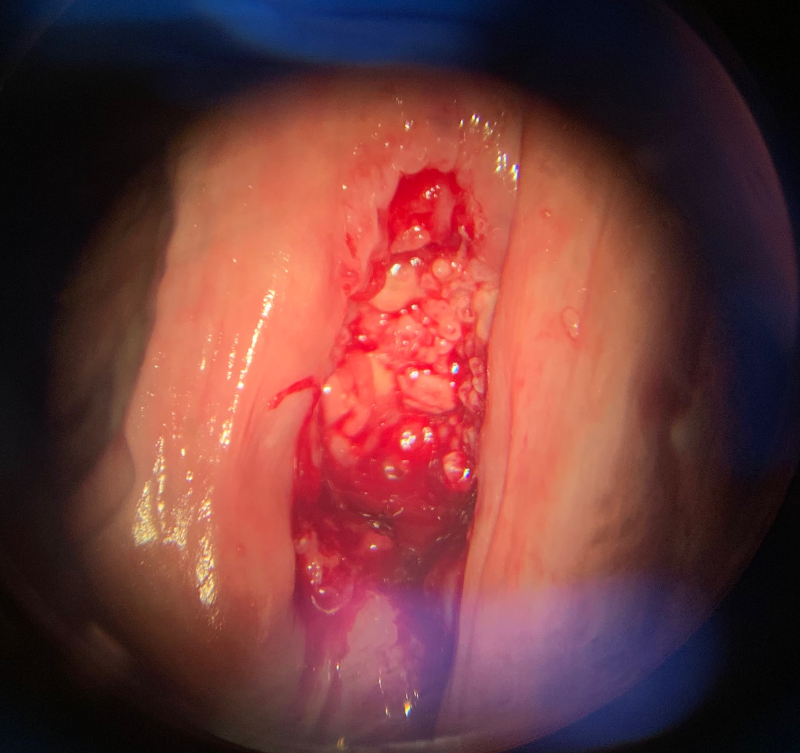
2. Objectives
Treatment of precursor intraepithelial lesions of invasive cervical, vaginal, and vulvar cancer in women infected with Human Papillomavirus.

Slide 7
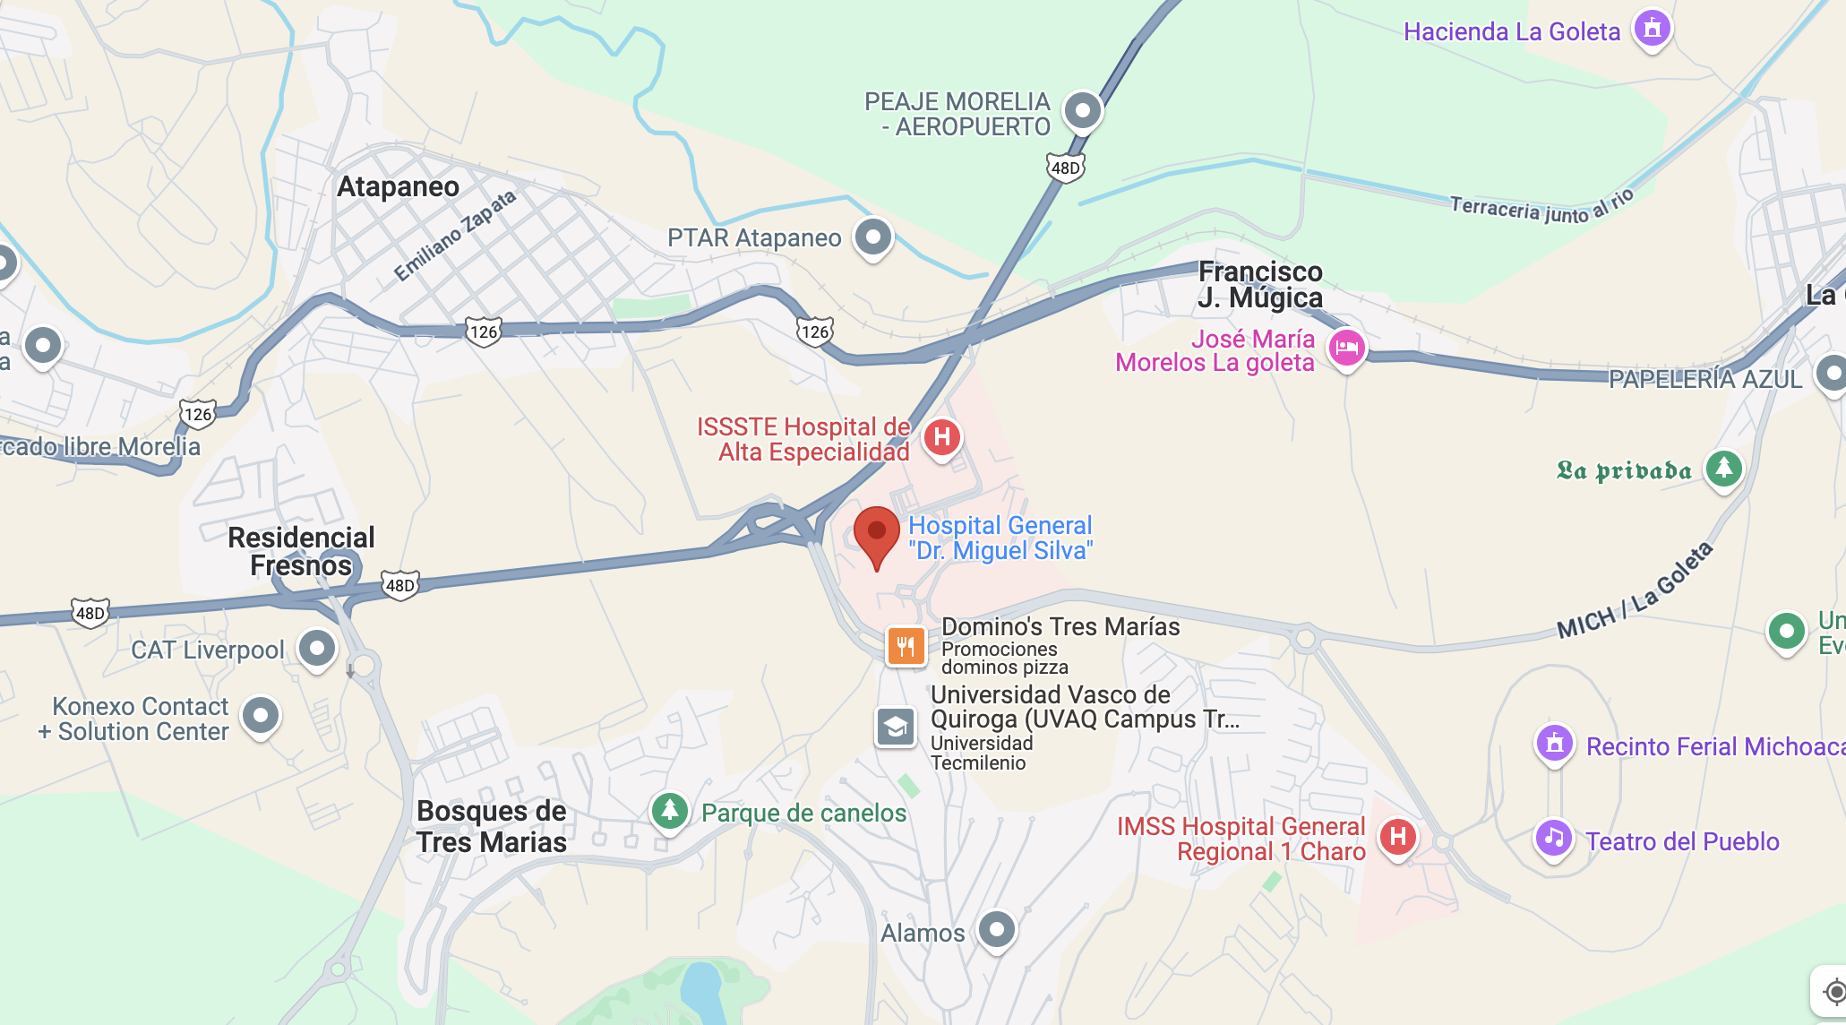
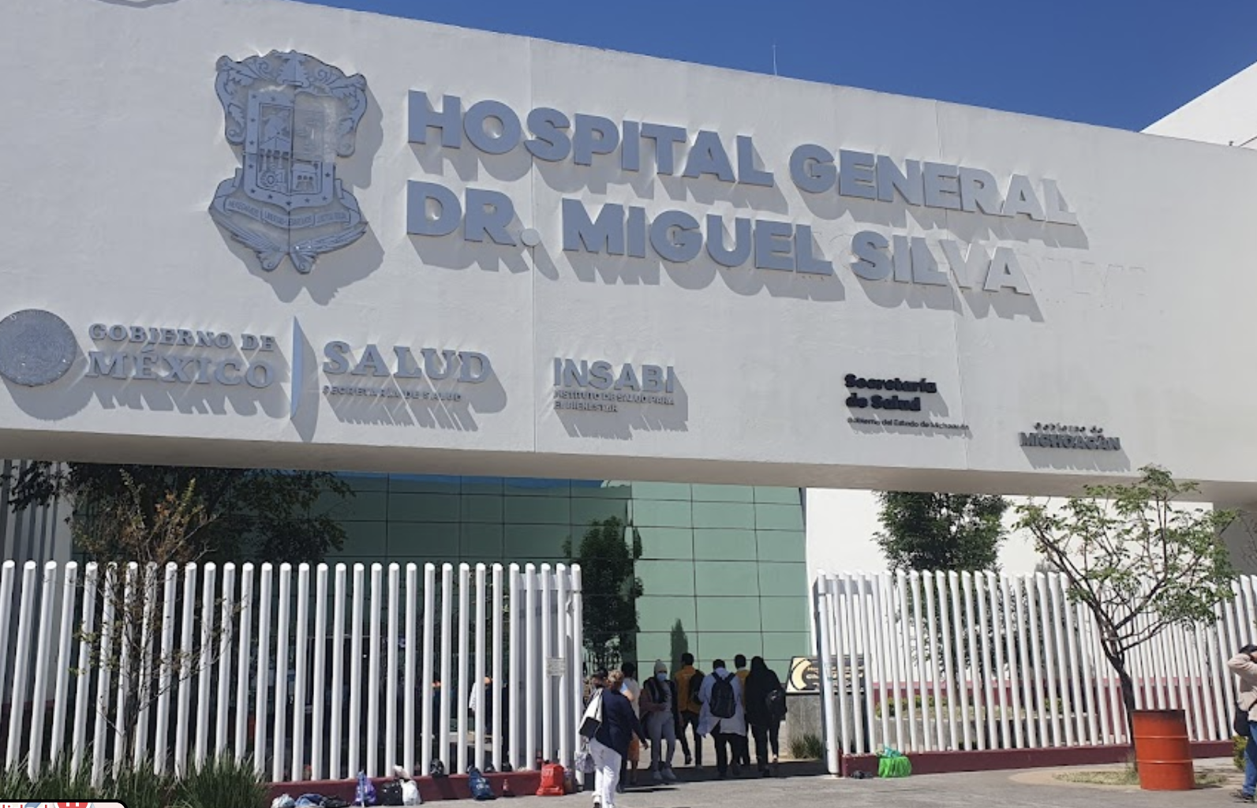
3. Location
Hospital General Dr. Miguel Silva, Morelia, Michoacán, Mexico
Bosques de Eucalipto # 415, Ejido de Atapaneo, 58253, Morelia, Mich. (443) 689-26-09

Slide 8
4. Budget Report
ITEM | QUANTITY | PRICE PER UNIT | TOTAL
CO2 Gynecological Laser DEKA SMARTXIDE MLT | 1 | US DLL$ 75 549.00 | US DLL$75 549.00
Micromanipulator for Colposcope for Surgical Laser | 1 | included in the price
TOTAL PROJECT COST |  |  | US DLL $ 75 549.00

Slide 10
5. Petition
Sponsor 1 Rotary Club …………...………….
Fondo Distrital FDD ……………………….
Rotary Club ………………………………
$
$
$
TOTAL PROJECT COST
US DLL $ 75 549.00

Slide 11
4. Budget Report
ITEM | QUANTITY | PRICE PER UNIT | TOTAL
CO2 Gynecological Laser Vasconcellos, Vasconcellos, Model: Luxelar Cabinet, 4 Modes. | 1 | US DLL$ 23 470.00 | US DLL$23 470.00
Micromanipulator for Colposcope for Surgical Laser | 1 | US DLL $ 4 976.00 | US DLL $ 4 976.00
TOTAL PROJECT COST |  |  | US DLL $ 28 446.00

Slide 12
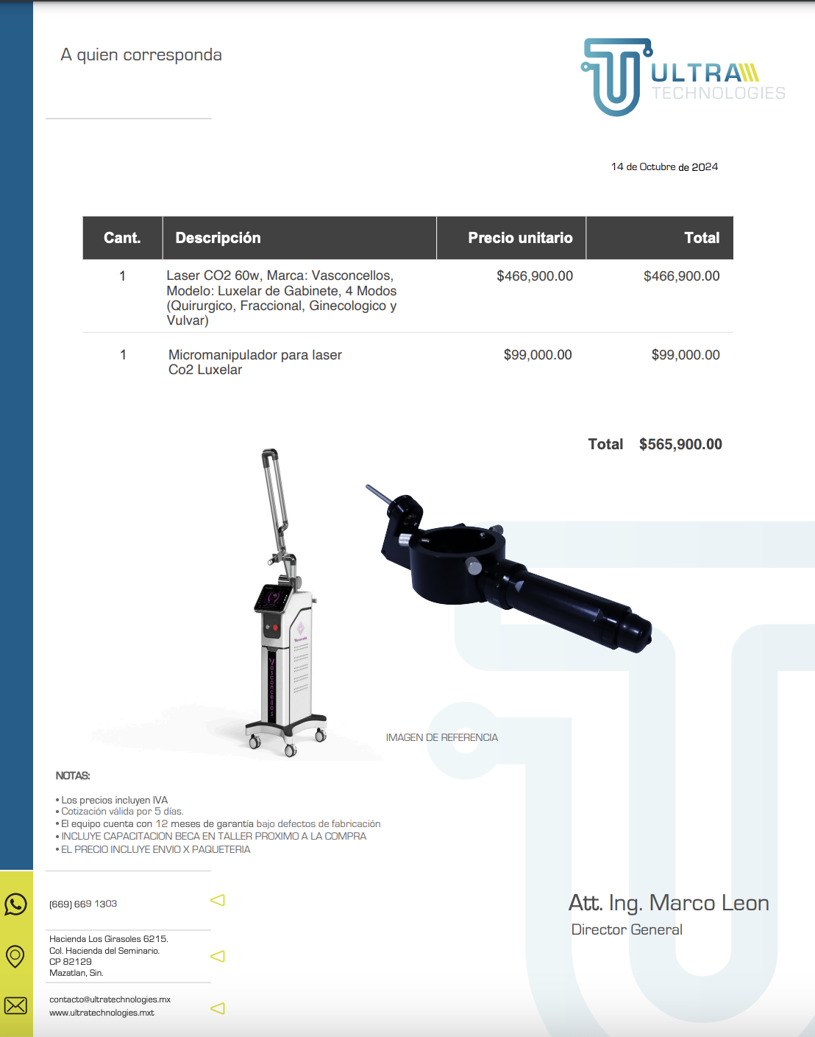

Slide 13
5. Petition
Sponsor 1 Rotary Club …………...………….
Fondo Distrital FDD ……………………….
Rotary Club ………………………………
$
$
$
TOTAL PROJECT COST
US DLL $ 28 446.00

Slide 14
6. Contacts
CONTACT 1
Dr. María Eugenia Contreras García
President, Rotary Club Morelia Tres Marías.
Phone number (+52) 443 410 1424
Email: eucontre@gmail.com
CONTACT 2
Dr. María Guadalupe González González
Head of the Colposcopy Clinic
Hospital General Dr. Miguel Silva .
Phone number (+52) 443 302 8538
Email: lupisglez2002@gmail.com

Slide 15
Club Rotario
Muchas Gracias

